Slide 1
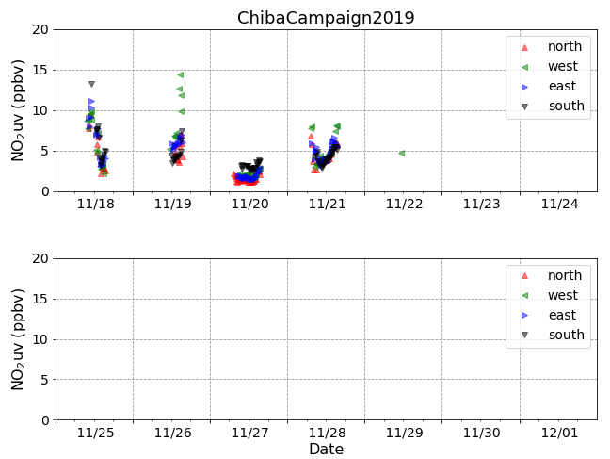
NO₂ time series
It was raining this weekend.
Therefore, data was not taken.

Slide 2
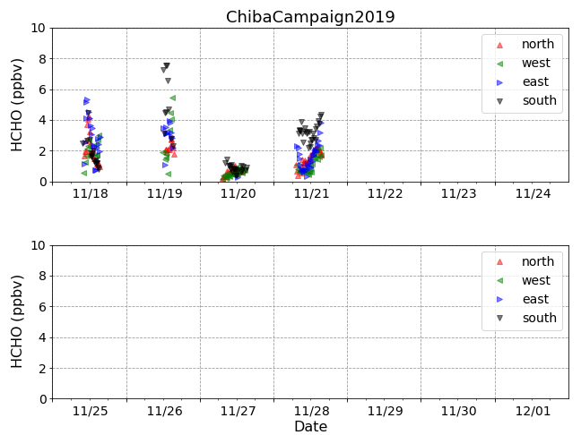
HCHO time series
It was raining this weekend.
Therefore, data was not taken.

